Slide 1
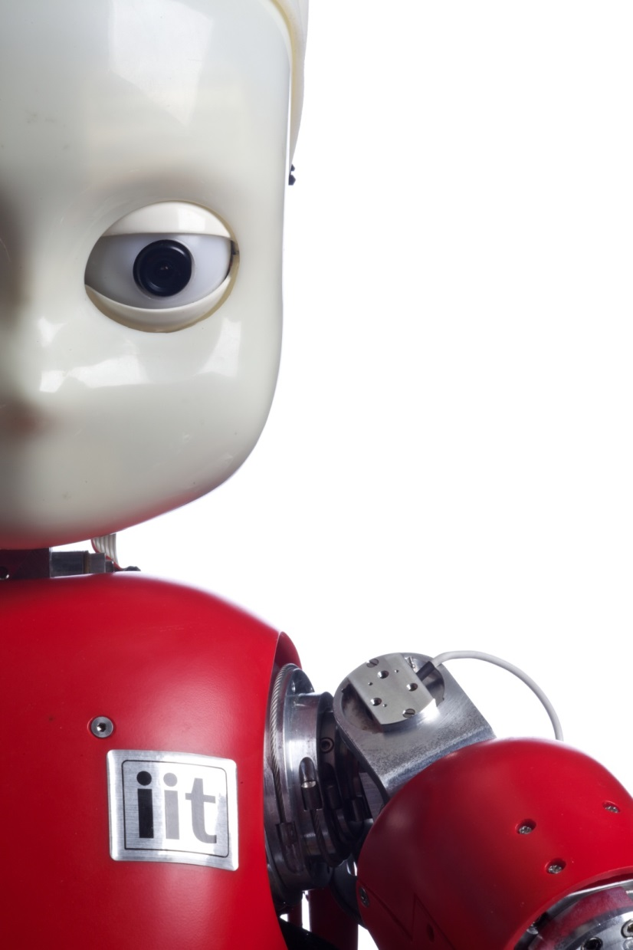

EPR WEB20 Crash Course

Slide 2
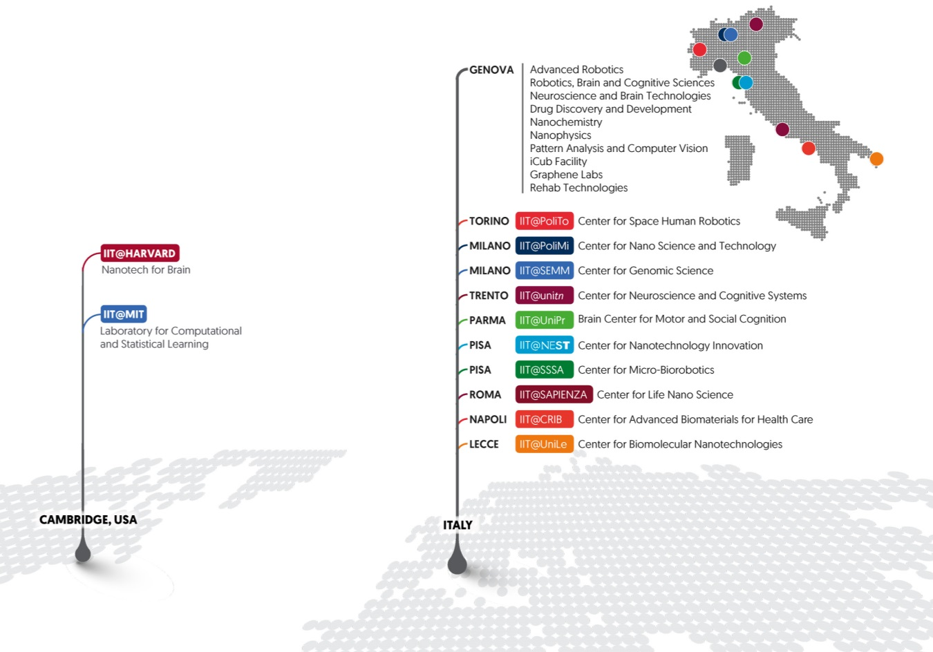
Istituto Italiano di Tecnologia

Slide 3
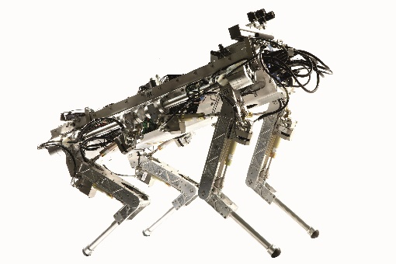
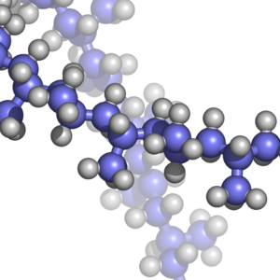
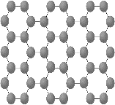
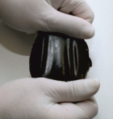
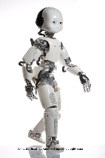
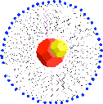
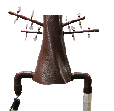
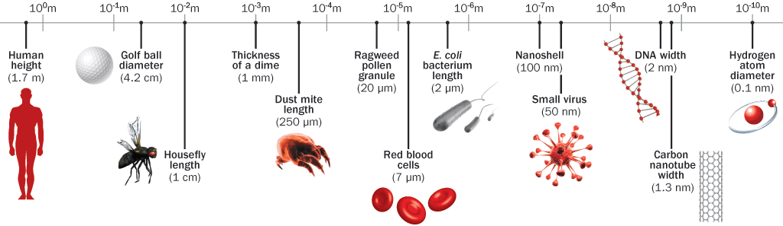
research domains
Materials for the environment
Graphene
Disaster recovery
Polymers for
robotics
Fabrication
Nanocrystals
Drug delivery
Environment monitoring
Sensors
Companion

Slide 4
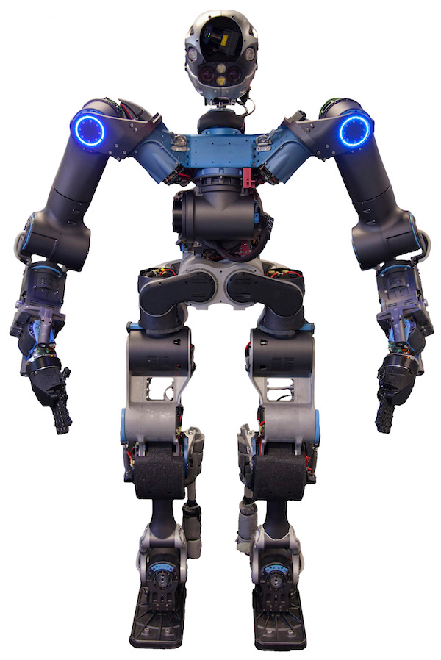
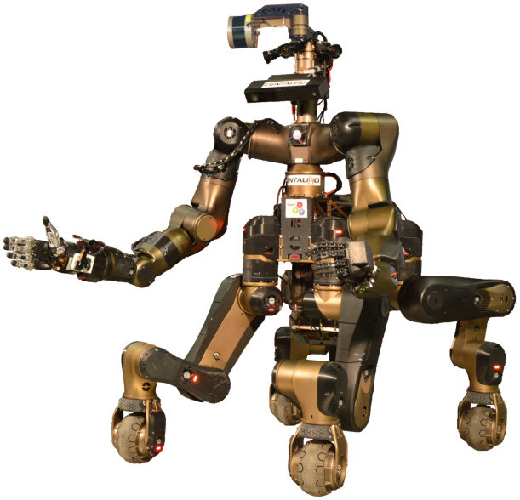
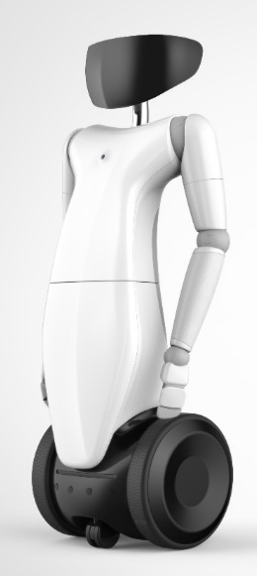
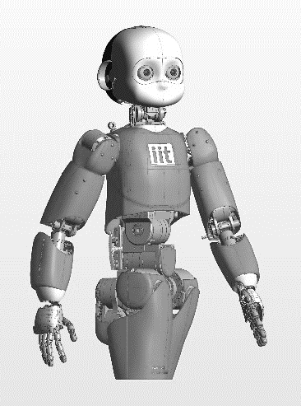
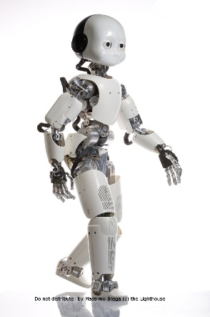
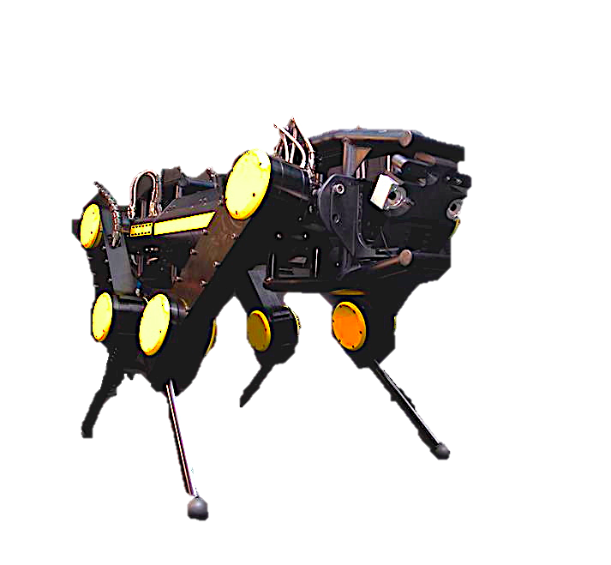
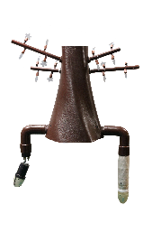
the IIT family
WALK-MAN
CENTAURO
R1
iCub3.0
iCub2.5
HyQ2Max
Plantoid

Slide 5

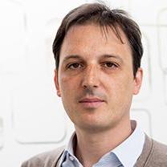
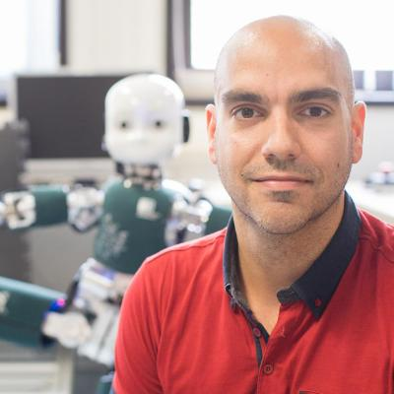
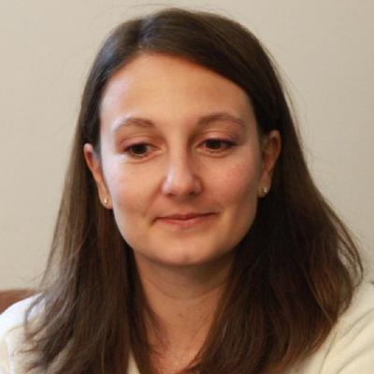
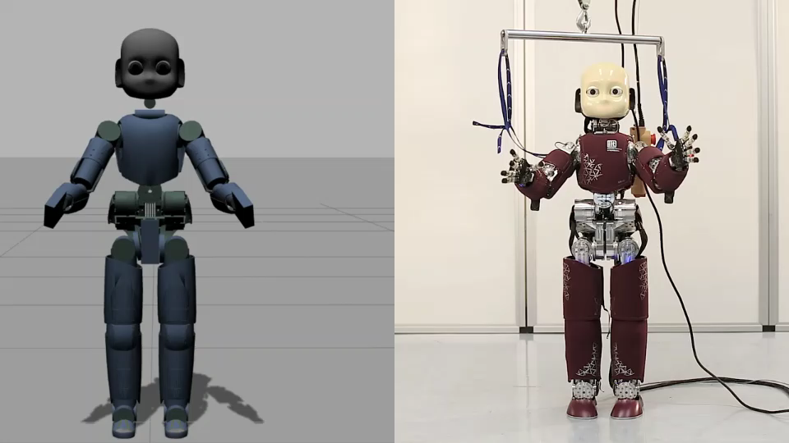
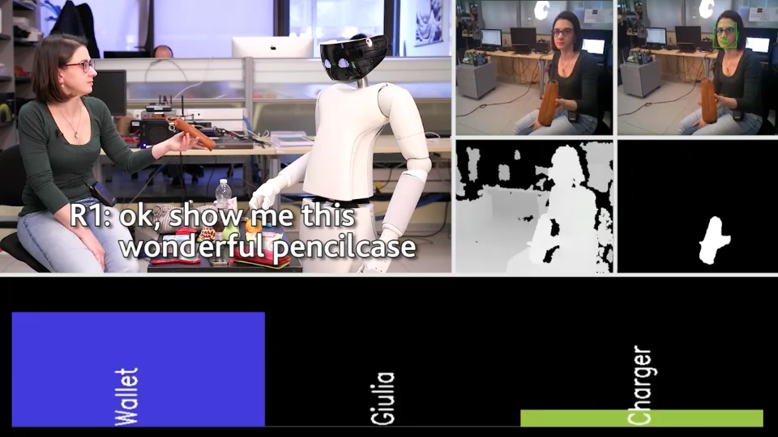
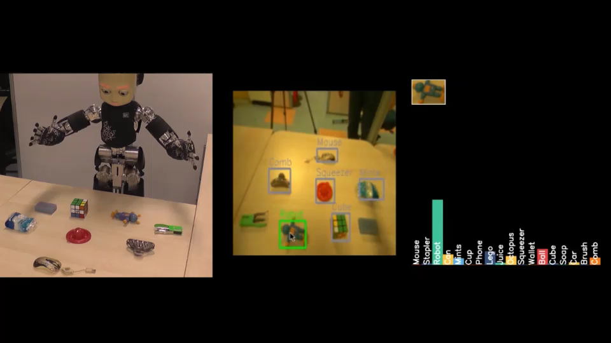
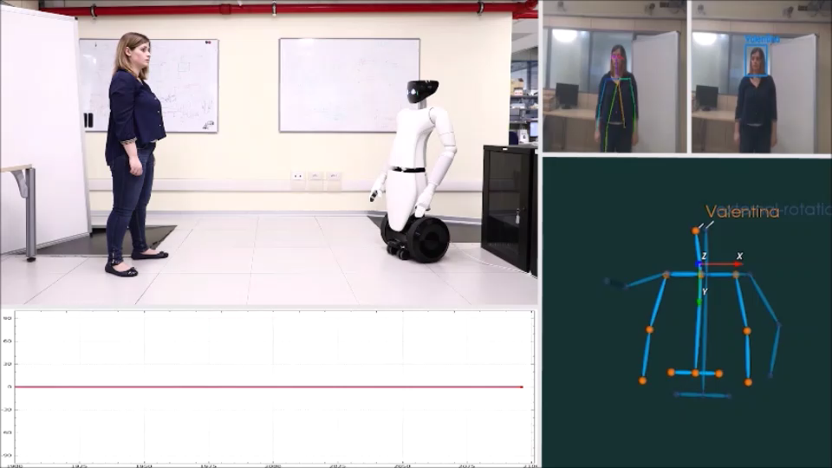
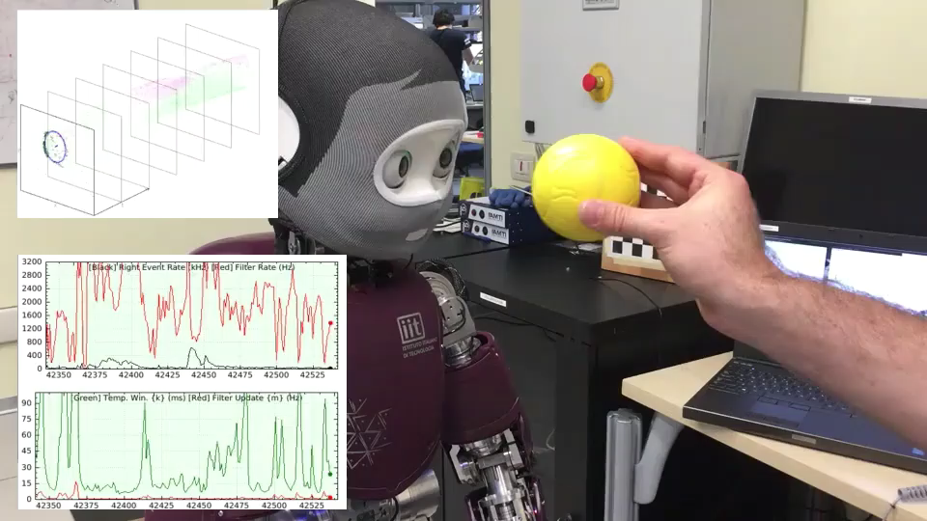
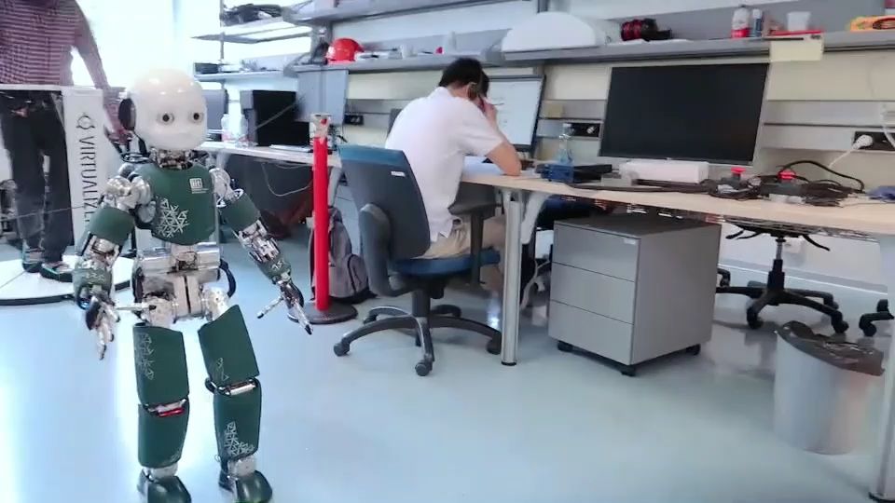
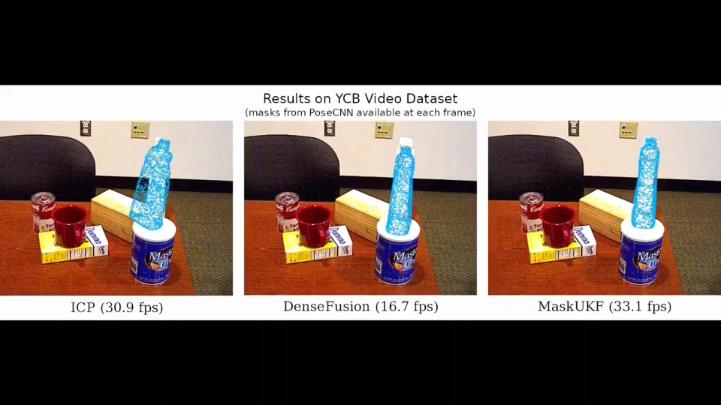
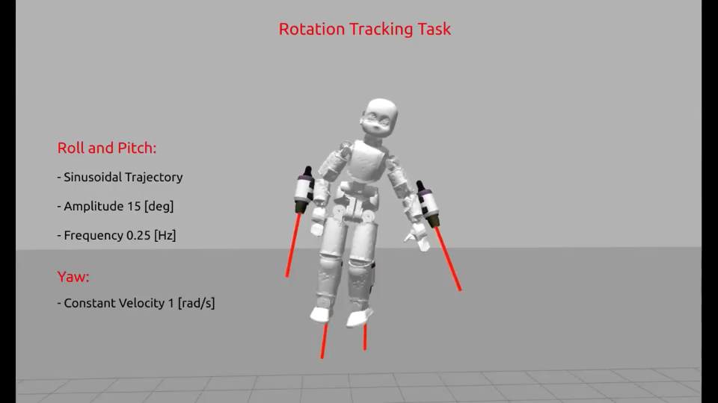
iCub research @ CRIS-IIT
iCub Tech
HSP
DIC
EDPR
iCub Tech Facility → Engineering
3 Research Lines → Science
M. Maggiali
L. Natale
D. Pucci
C. Bartolozzi
dynamic control
interaction
objects learning
assistive rehab
event-driven cameras
tele-existence
pose estimation
aerial humanoids

Slide 6
ICT + robotics
Non-robotics companies investing in robotics!
Tesla – open AI foundation
Google – Deep Mind + robotics
Toyota – AI, robotics, cars
Facebook – machine learning, AI
IBM – AI, Watson
Softbank – robotics
Nvidia – «The AI company»
many more…

Slide 7
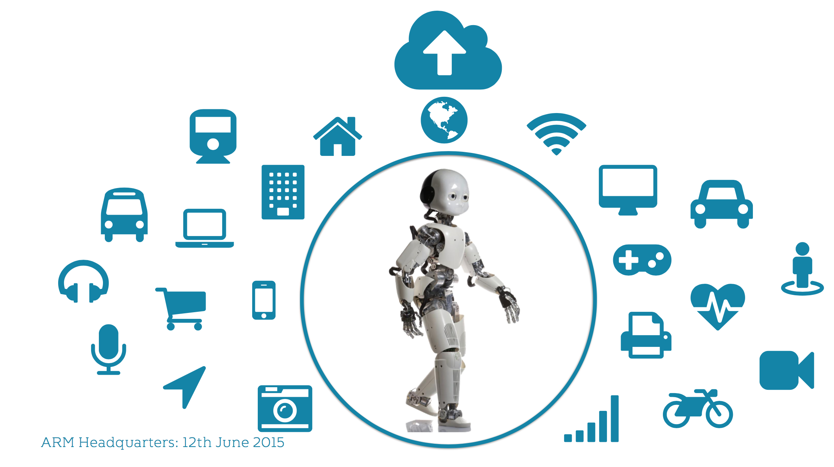


ICT + robotics
present
Non-robotics companies investing in robotics!
Tesla – open AI foundation
Google – Deep Mind + robotics
Toyota – AI, robotics, cars
Facebook – machine learning, AI
IBM – AI, Watson
Softbank – robotics
Nvidia – «The AI company»
many more…

Slide 8
ICT + robotics
future ?
Non-robotics companies investing in robotics!
Tesla – open AI foundation
Google – Deep Mind + robotics
Toyota – AI, robotics, cars
Facebook – machine learning, AI
IBM – AI, Watson
Softbank – robotics
Nvidia – «The AI company»
many more…

Slide 9


course program
DAY 1
YARP (MW)
Basic CAD Design
DAY 2
Control (PID)
Vision (Model Matching)
DAY 3
Team Contest Dev
DAY 4
Diversified audience
Only very basic theory…
…with lots of practice!

Slide 10
course program
DAY 1
YARP (MW)
Basic CAD Design
DAY 2
Control (PID)
Vision (Model Matching)
DAY 3
Team Contest Dev
DAY 4
💊 Pills on Soft Skills
Problem solving
Taking initiatives, achieving goals
Collaboration, communication
Diversified audience
Only very basic theory…
…with lots of practice!

Slide 11


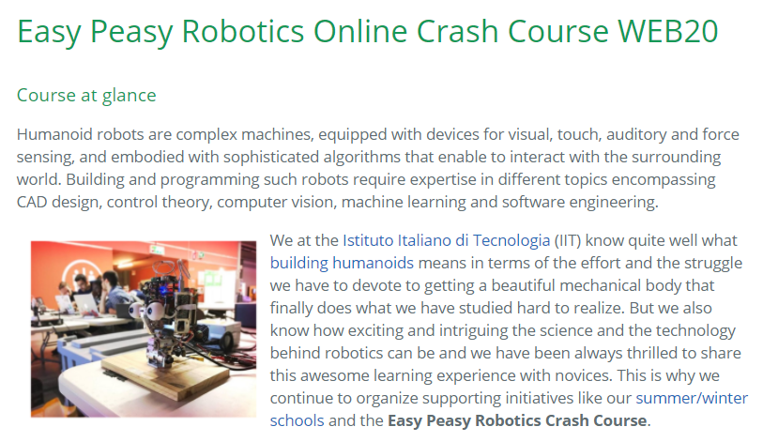
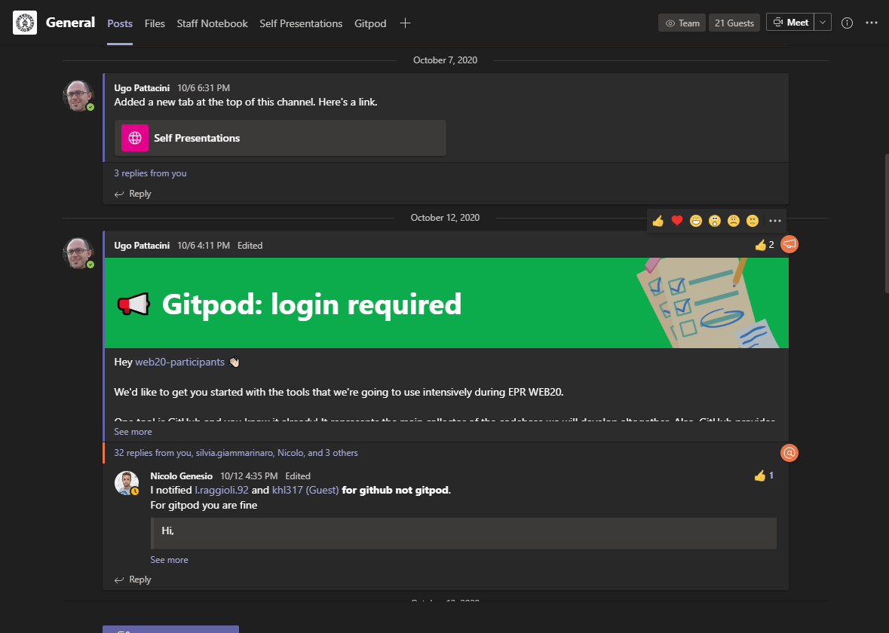
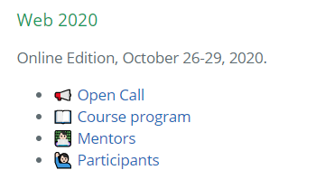
EPR tools
GitHub
https://easy-peasy-robotics.github.io
MS Teams
easy-peasy-robotics

Slide 12


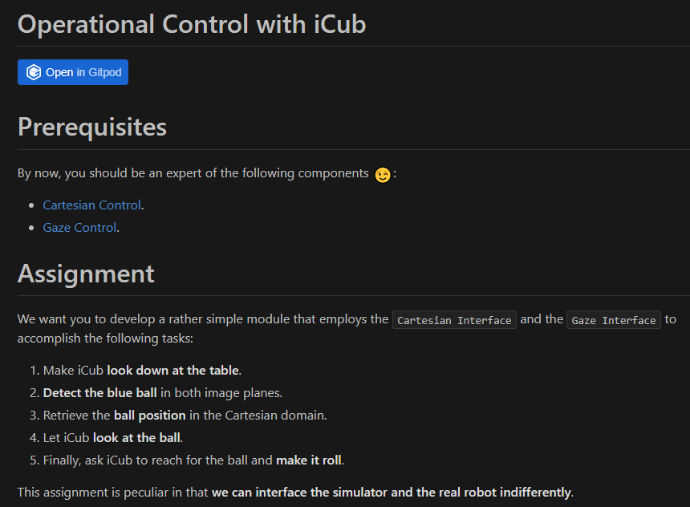
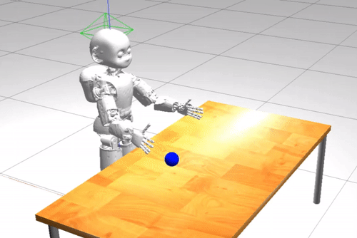
EPR tools: GitHub Classroom
RTF tests solution automatically,
locally & remotely
Assignment with starter code
turn in solution (push)

Slide 13
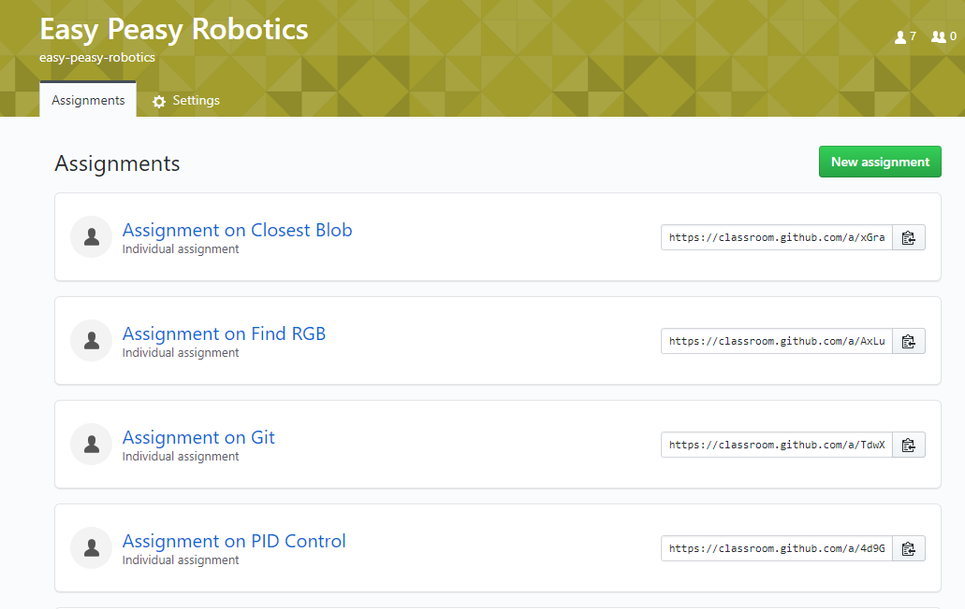
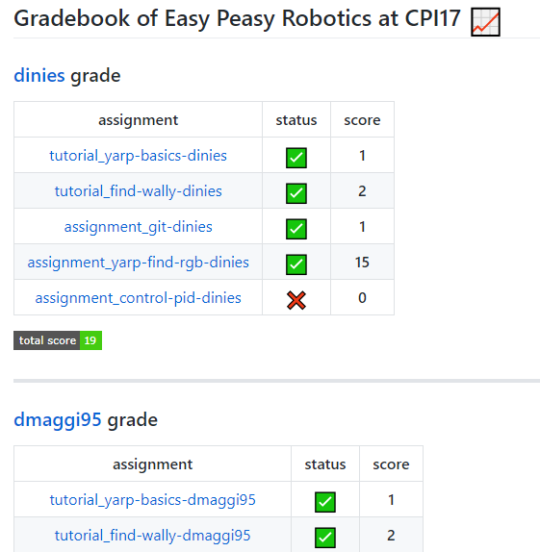
EPR tools: GitHub Classroom
Classroom dashboard
J.Fiksel et al., “Using GitHub Classroom to Teach Statistics”, 2019
R.Glassey, “Adopting Git/GitHub within Teaching”, 2019
A.Zagalsky et al., “The Emergence of GitHub as a Collaborative Platform for Education”, 2015

Slide 14


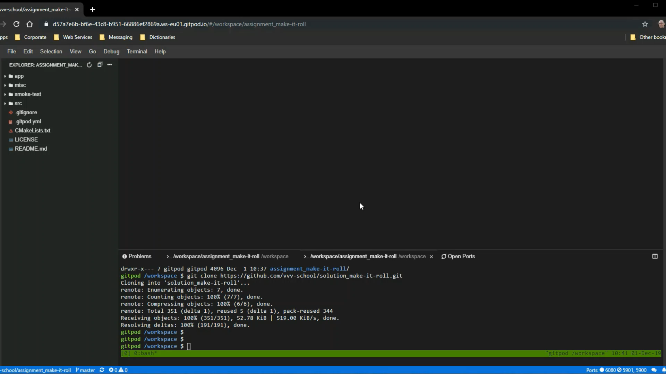
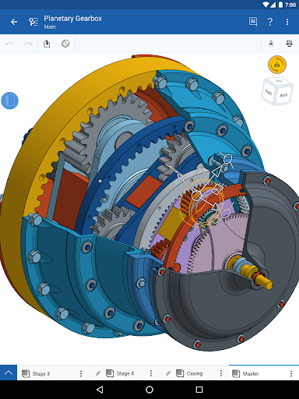
EPR tools: Cloud IDE
Sparing the installation burden
Gitpod: load Docker image into a Cloud workspace

Slide 15
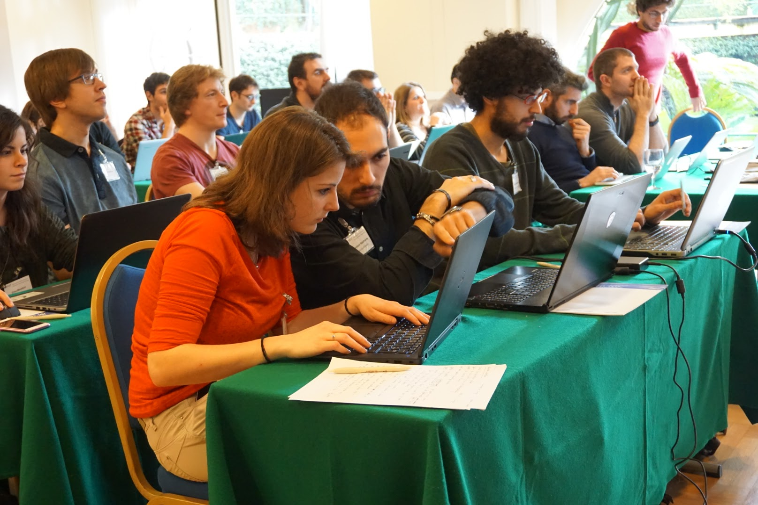
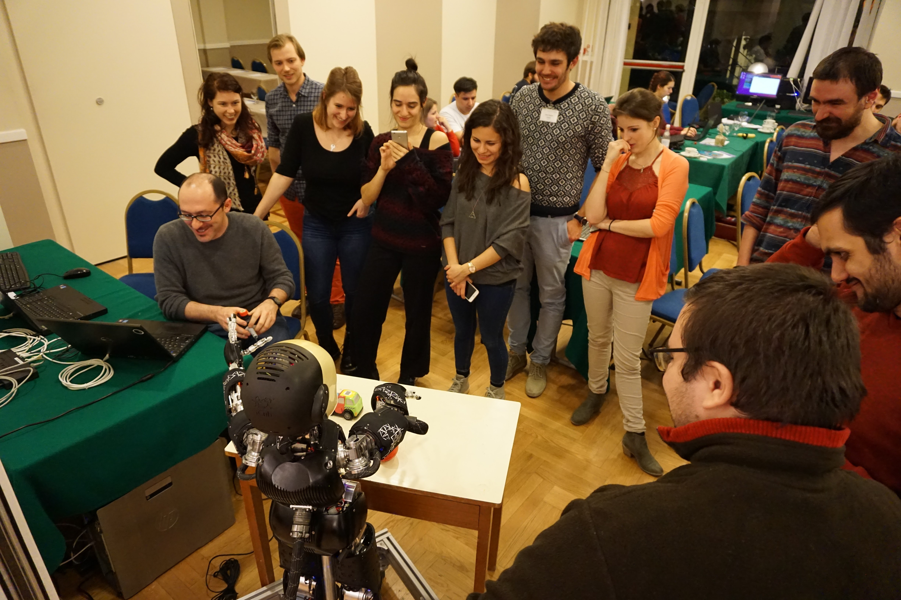

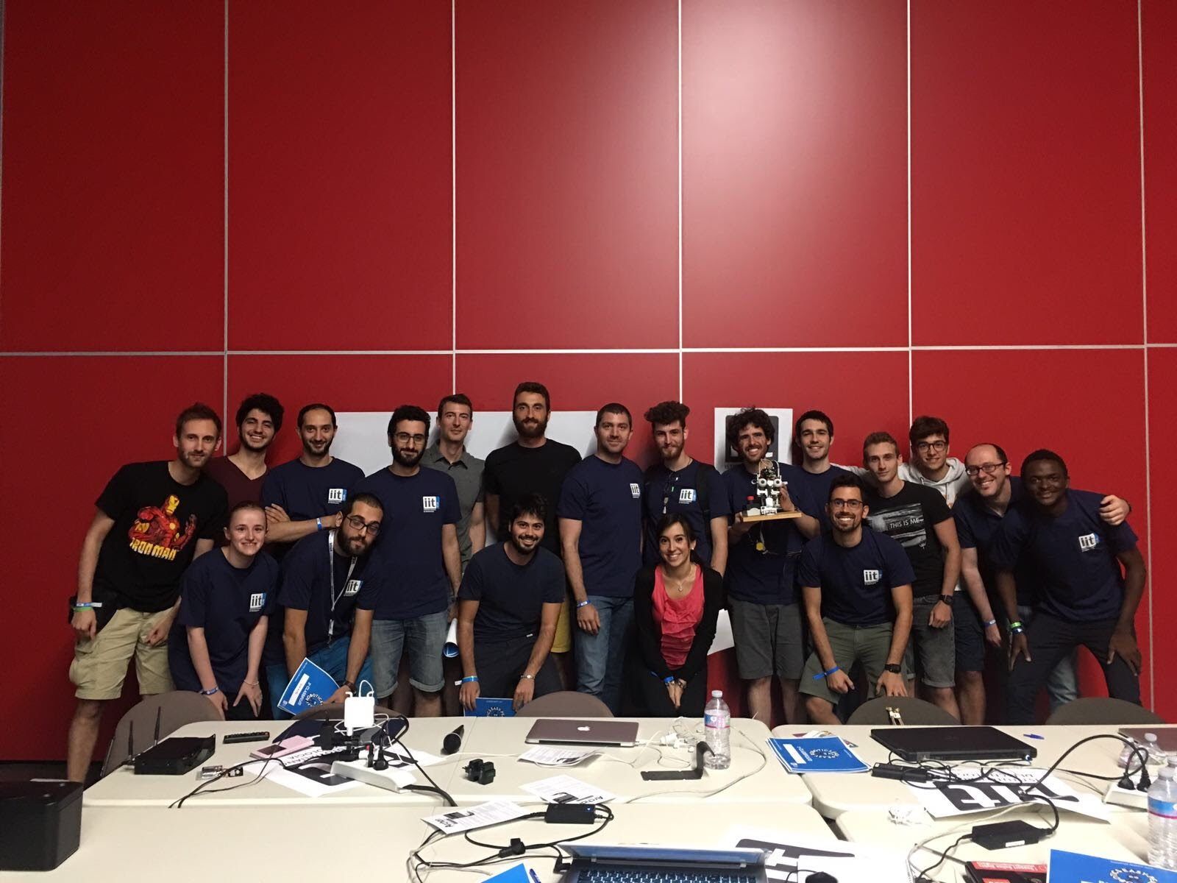
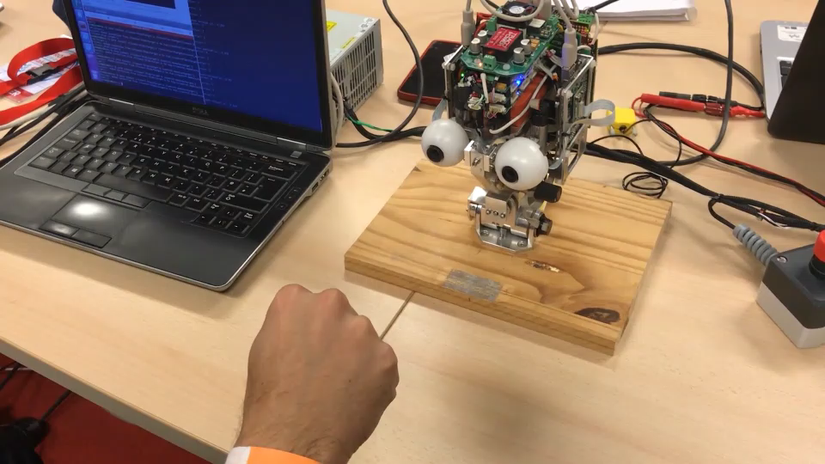
schools & crash courses
International Winter School on Humanoid Robot Programming https://github.com/vvv-school
VVV-18
VVV-17
https://github.com/easy-peasy-robotics
from ZERO to HERO in 2 Days !!
CPI-18
MFR-17
CPI-17

Slide 16




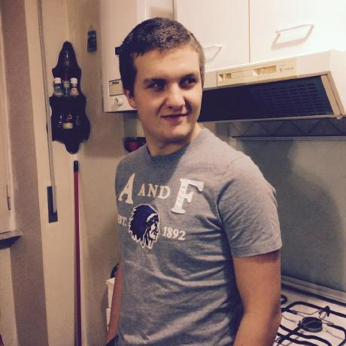









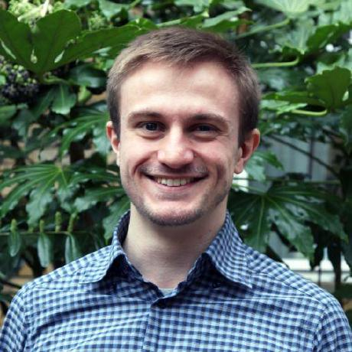




participants
@wenxuanmou
@MSIhub
@AkashSingh123
@ArekBerc
@mett96
@igng
@Nesheit
@kevinklenmatira
@albertoeto
@ag9217
@claudioverardo
@arshad-heravi
@sigeek
@abdelhakim96
@francescosemeraro
@MartinaRuocco
@lucarag
@Nosilil
@khlee0697

Slide 17



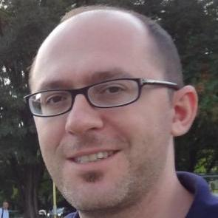


mentors
@Nicogene
@vvasco
@traversaro
@pattacini
@vtikha
@salvi-mattia

Slide 18
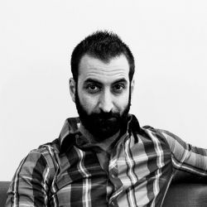


thanks to
Luca Caridà
Enrico Di Piazza
Irene Rivara

